Slide 1

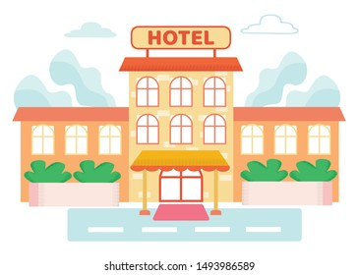
The hotel review analysis

Slide 2
Presentation Highlights
Problem Statement & Objective
Detailed Design Description
Experiment and Results
Creative Approaches
Shortfall Identification
Questions

Slide 3
Presenting Our Idea in One-Minute

Slide 4
Problem Statement & Objective
Generally, people have a usual tendency to go through the reviews of a hotel before booking for a stay, but one might look at 10-15 reviews and not more to get a general idea about the hotel.
This project intends to provide a quick comparison between two hotel by taking account of the reviews received so far, which is used to understand which hotel is better than the other.

Slide 5

Detailed Design Description
Step 1: Data Extraction
Step 2: NLP Pre Processing
Step 3: Binary Conversion
Step 4: Association Rule
Step 5: Finding Max Support
Step 6: Compactness Pruning
Step 7: Redundancy Pruning
Step 8: Polarity

Slide 6
Step 1: Data Extraction
Sources | Hotels reviews are considered from Makemytrip.com, goibibo.com
Which City | Goa
What we scraped: | Reviews, Ratings, Hotel Names
Libraries and Tools Used: | Python, Microsoft Excel, Chrome Extension ‘Web Scraper’
No. of reviews scraped: | 6047

Slide 7
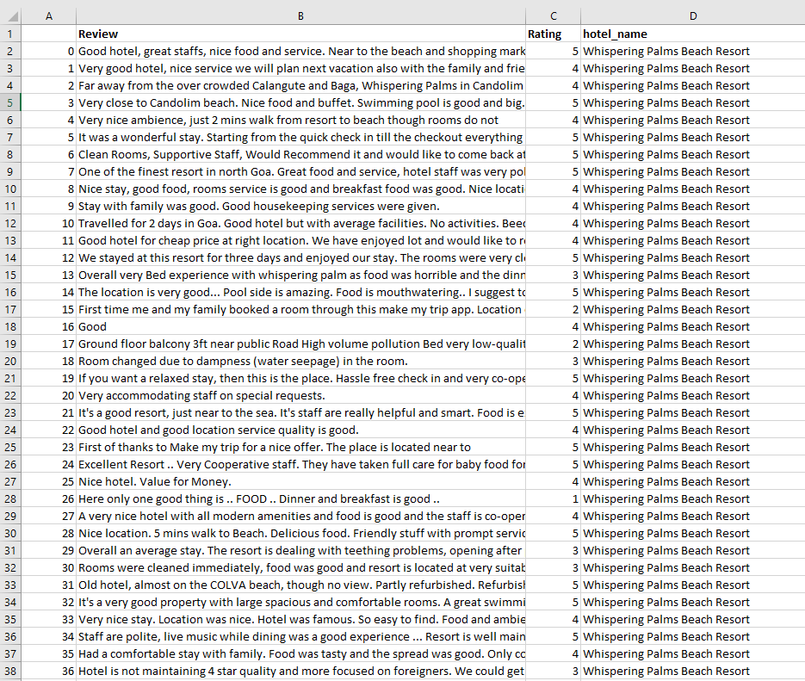
Snapshot of Data Extraction

Slide 8
Step 2: NLP Pre Processing
Procedure 1: Remove Punctuation
Procedure 2: Converting Text into Lower Case
Procedure 3: Remove Extra Space
Procedure 4: Remove Emoji
Procedure 5: Tokenization
Procedure 6: Remove Less Than Two Words
Procedure 7: Common Noun Tag
Procedure 8: Converting Text into Singular Text

Slide 9
Procedure 1: Remove Punctuation (!"#$%&\'()*+,-/:;<=>?@[\\]^_`{|}~)
‘Money’. → Money
Procedure 2: Converting Text into Lower Case
Money → money
Procedure 3: Remove Extra Space
‘ Worth for Money ‘ → ‘Worth for Money’
Procedure 4: Remove Emoji
The resort is very good 😍 → The resort is very good

Slide 10
Procedure 5: Tokenization
The resort is good, breakfast is good. Staff service is too slow → [[ The resort is good breakfast is good], [Staff service is too slow]]
Procedure 6: Remove Less Than Two Words
The resort is good → The resort good
Procedure 7: Extracting Common Noun Tag
The resort is very good → resort (Common Noun)
Procedure 8: Converting Text into Singular Text
Houses → House, Cities → City

Slide 11
Step 3: Binary Conversion
After extracting the nouns from the reviews, the feature(noun words) is then converted into binary matrix form representing the occurrence of that noun in that each review.
The binary converted nouns are then used for association rule mining to understand the relationship of two or more features(nouns).

Slide 12
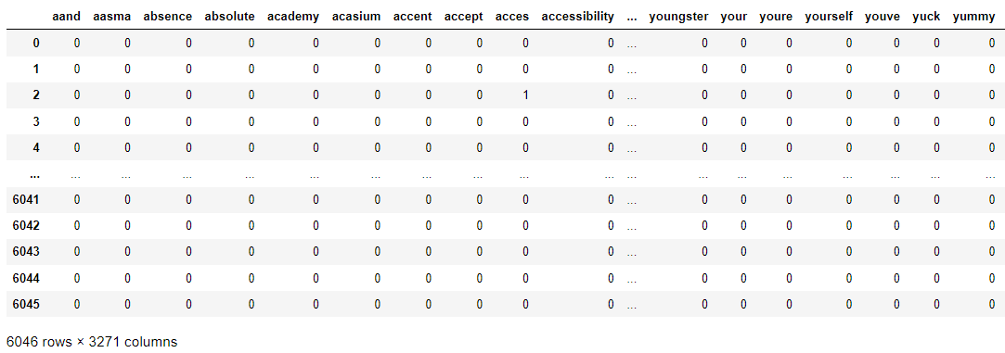
Snapshot of Binary Conversion

Slide 13
Step 4: Association Rule
Association rule mining:-
Association rule mining is the data mining process of finding the rules that may govern associations and causal objects between sets of items. So, in each transaction with multiple items, it tries to find the rules that govern how or why such items are often bought together.
Support and confidence :-
Support is an indication of how frequently the items appear in the data. Confidence indicates the number of times the if-then statements are found true.

Slide 14
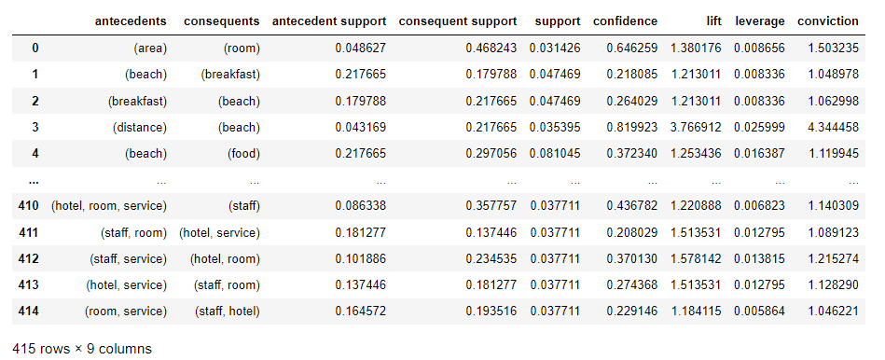
Snapshot of Association Rule

Slide 15
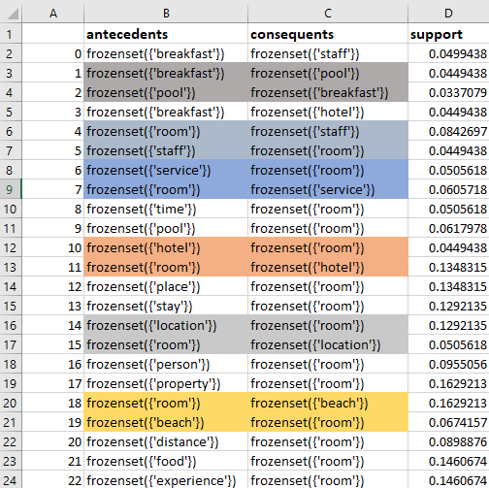
Step 5: Finding Max Support
Here we are trying to find the max support value for different feature as well as, we are trying to remove duplicate values like(resort ,room / room , resort )Which were present in antecedents and consequents.

Slide 16
Step 6: Compactness Pruning
From max support we get all the frequent item set, but not every item set can be considered as a feature so we use two types of pruning to remove the redundant nouns.
There are feature which has two words in it and few of them wont make sense when placed together in a sentence, so to remove those kind of feature we can use compactness pruning. You can consider a feature compact when both the words are separated in an sentence by at most 3 words.

Slide 17
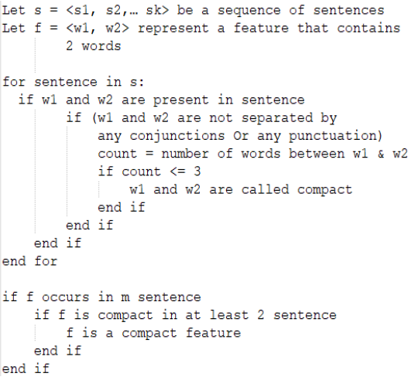
Snapshot of the Process

Slide 18
Example for Compactness Pruning
Feature :[Hotel, Room]
You can see that The minimum no of words between hotel and room is 2 so we can consider the feature is a compact feature. But there might be more than 2 pair of Hotel Room combination, so for that we should consider both of the combination and see which has the lowest no of words .for example in the below sentence you can see there is 2 combination of hotel and room the first combination has 3 words between them and 2nd combination has 9 words between them.

Slide 19
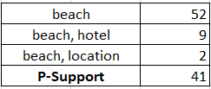
Step 7: Redundancy Pruning
This method is used to eliminate those single feature who has no meaning in a sentence by itself . This is done by calculating the p-support of the feature.
P-support is the number of the feature repeats in a paragraph by itself without considering the superset of the feature.
For Example For The feature Beach We can see the count of the subsets of ‘Beach’ , and the total count of beach in the reviews.so the psupport of the feature beach would be, (52-(9+2).

Slide 20
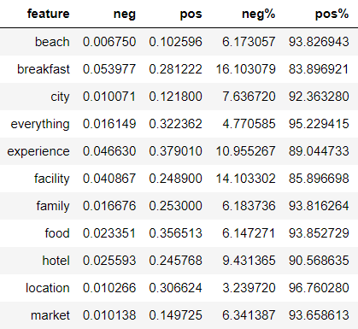
Step 8: Polarity
Now we have all the Features so our next step is to get the semantic orientation of each opinion word. We focussed both on the polarity and the strength of the polarity. For that We have used the VADER (Valence Aware Dictionary and Sentiment Reasoning) .sentiment analysis tool. This tool returns us the intensity of the polarity strength as value between -1 to +1.

Slide 21
Experiment and Results
Result
Deployment

Slide 22
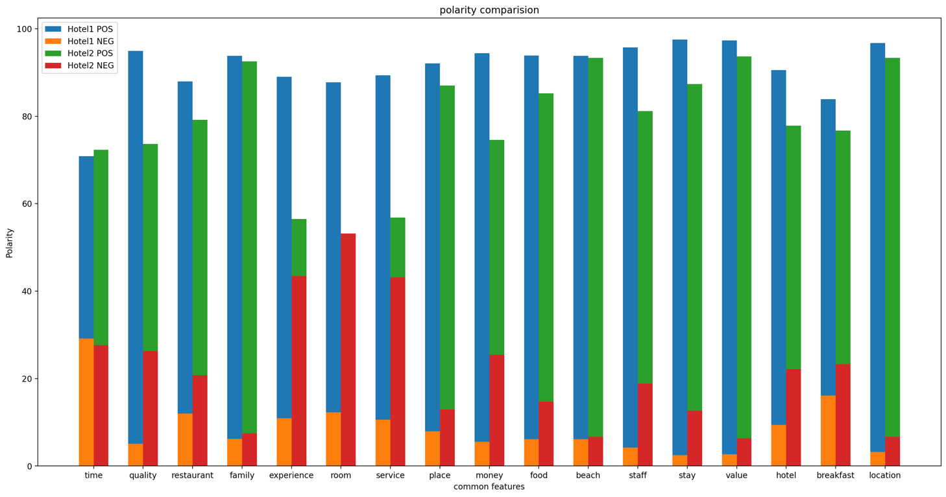
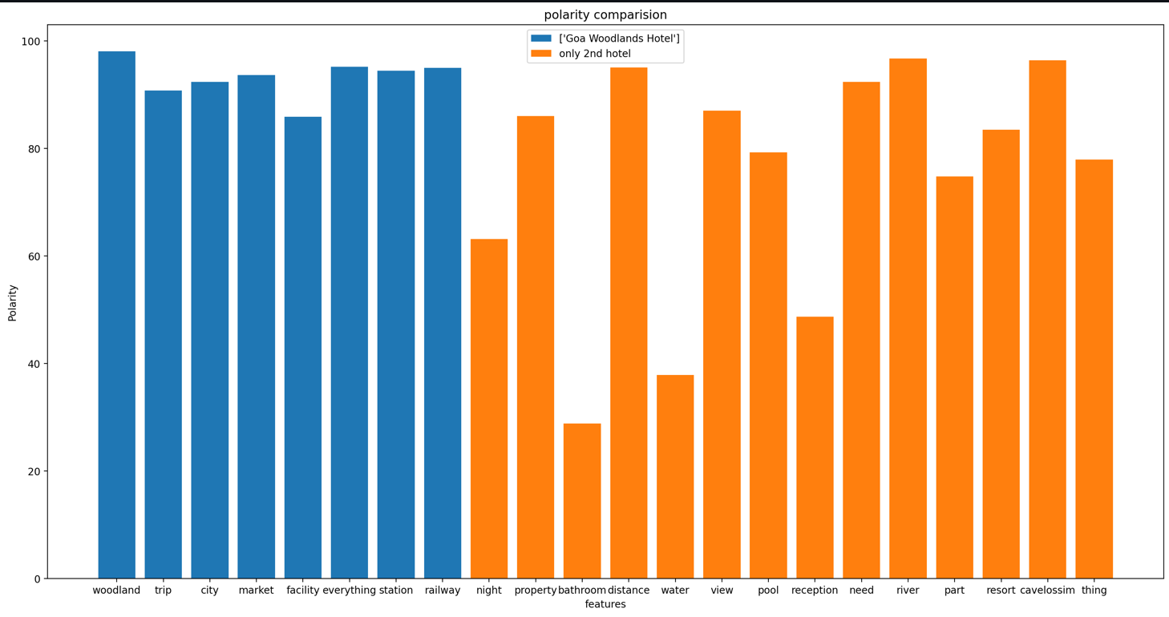
Results

Slide 23
Quick Deployment Demo - Using streamlit & Heroku

Slide 24
Shortfall Identification
Limitation :
Lack of resource & Lack of computing power
Future Scope:
We have used single feature noun & in future we can scale it up to 2 feature model.
Now we're able to compare two hotel at a time but it is scalable to 3 hotel comparison at a time.
Clustering can be used to achieve better performance

Slide 25

Mentor
PROF. GOURAB NATH

Slide 26





Our Team
Yogesh Babu
Vishwak Balaji
Neha Afreen
Lalit Kumar
Shameel Zeshan

Slide 27

Thank You

Slide 28

Questions

